Slide 1

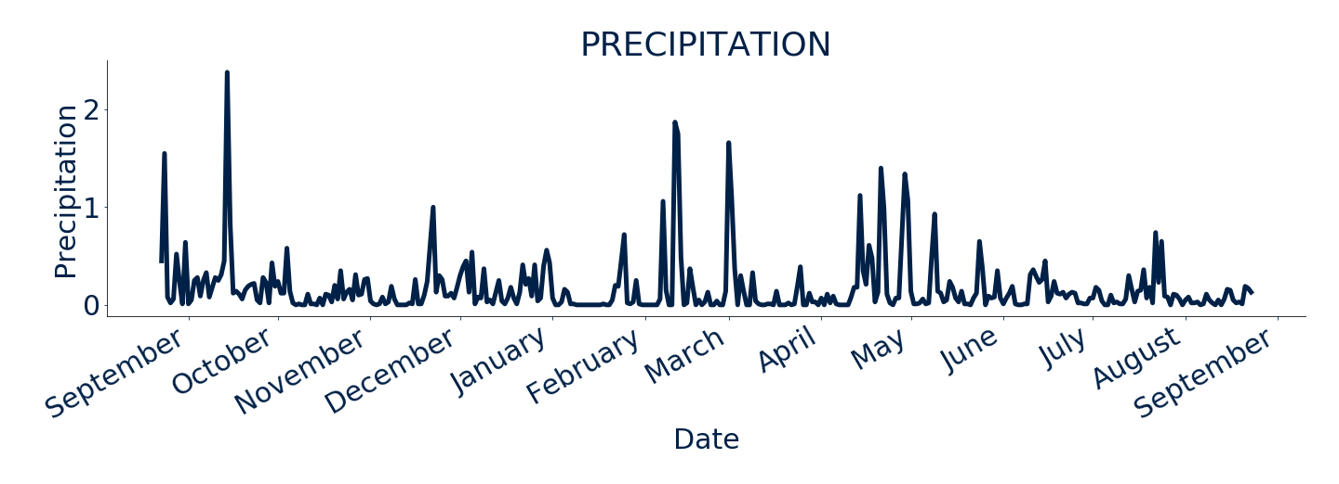
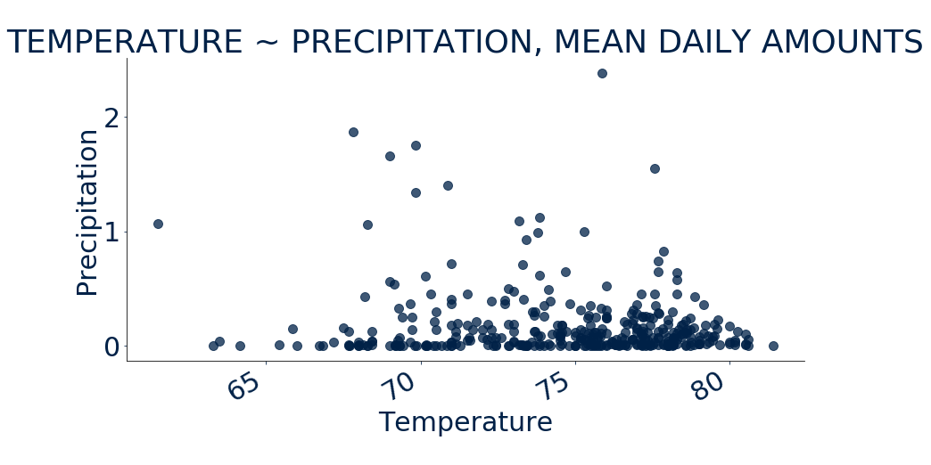
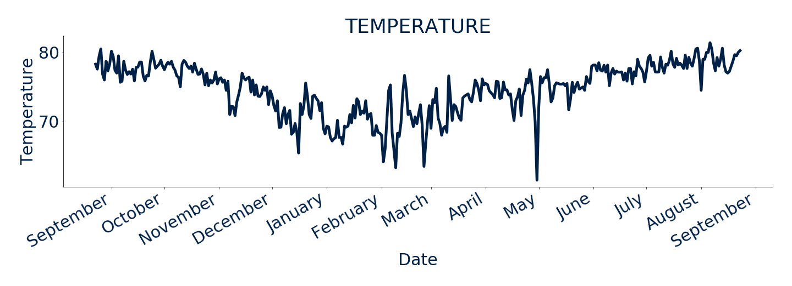


ONE CALENDAR YEAR OF HAWAII WEATHER
AUGUST
23rd,
2016
DAILY PRECIP | $μ=0.17"$
to
AUGUST
DAILY TEMP $| μ=74.68℉$
23rd,
2017

Slide 2

ClimatePy
TOM CALLEGARI
JULY 2019

Slide 3
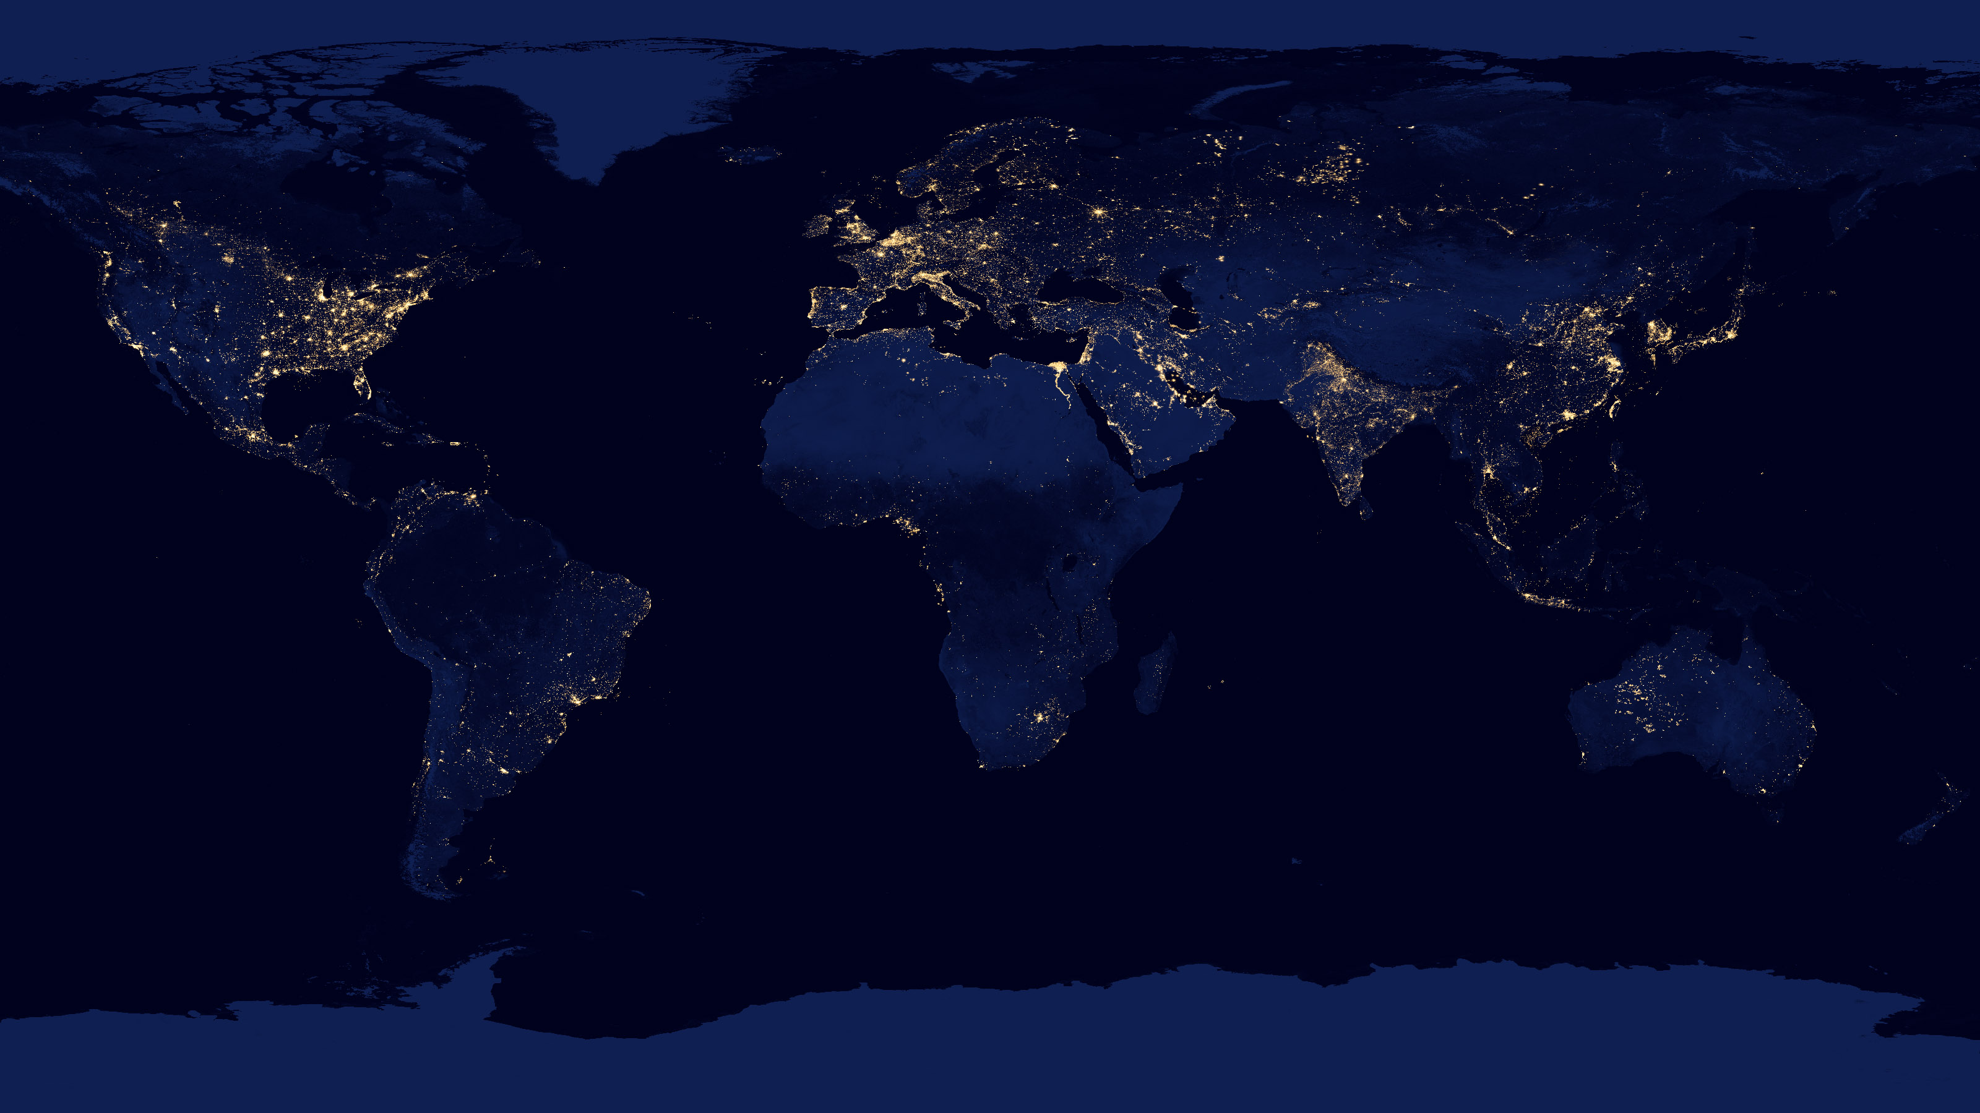

GLOBAL WEATHER & LATITUDE
TOM CALLEGARI
AUGUST 2019

